Slide 1



Hardware-Efficient Ansatz Design
and Noise-Aware Analysis of a Variational Quantum Classifier for IQM Spark
Axion
Student Research Group
Iwo Wojtakajtis*, Maria Płatek*, Rafał Balicki*, Michał Szczęsny*, Karina Leśkiewicz*, Tomasz Kajdanowicz
2026 IEEE International Conference on Quantum Control, Computing and Learning
Aalborg, Denmark

Slide 2

Idea:
Axion
Student Research
Group
Measuring problem metrics on QPU is computationally heavy. We need protocol to evaluate ansatz with smaller cost.
09 / 16

Slide 3
Idea:
Axion
Student Research
Group
Measuring problem metrics on QPU is computationally heavy. We need protocol to evaluate ansatz with smaller cost.
Problem:
Simulator based test results don’t always align with their hardware equivalents.
09 / 16

Slide 4
Idea:
Axion
Student Research
Group
Measuring problem metrics on QPU is computationally heavy. We need protocol to evaluate ansatz with smaller cost.
Problem:
Simulator based test results don’t always align with their hardware equivalents.
Solution:
We propose a protocol fully based on hardware computation.
09 / 16

Slide 5
A QPU-Side Verification Framework
Axion
Student Research
Group
Our contribution: three hardware-measurable metrics that together verify an ansatz on the QPU.
Fidelity - how well can we represent the ideal state?
KL - expressibility - how does QPU noise change expressibility?
Meyer - Wallach - how entangled is each qubit?
All three are conducted on-device and together give insight on on-hardware behavior.
09 / 16

Slide 6
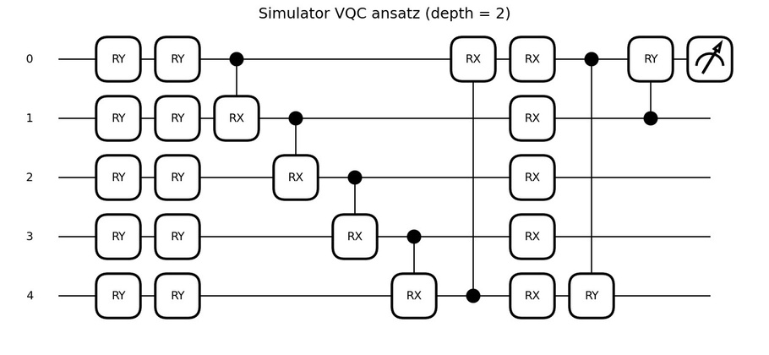
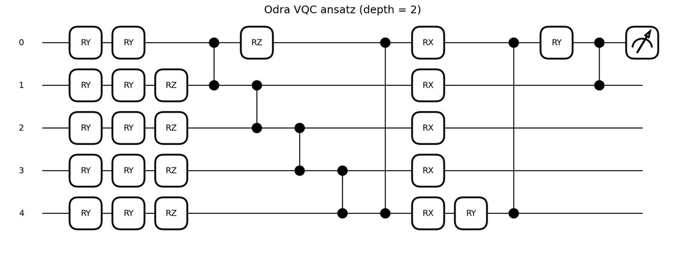
Two Ansatz Families - case study
Axion
Student Research
Group
ansatz_simulator
ansatz_odra
CRX / CRY / ring entanglement
RZ + CZ native / ring entanglement
parameterized entangling gate
parameterized gate + native entangling gate
S. Sim, P. D. Johnson, and A. Aspuru‐Guzik, "Expressibility and entangling capability of parameterized quantum circuits for hybrid quantum‐classical algorithms," Adv. Quantum Technol., vol. 2, no. 12, p. 1900070, Dec. 2019, doi: 10.1002/qute.201900070.
08 / 16
Notes:
zaznaczyc strzlka roznice

Slide 7
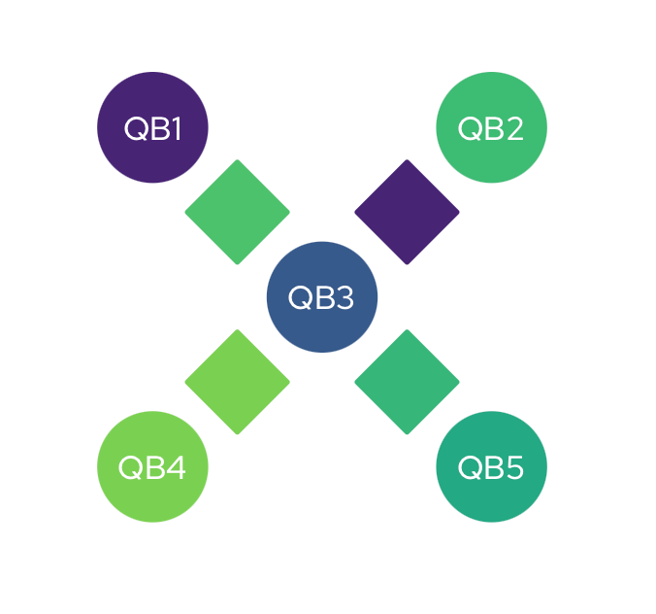
Experimental setup - case study
Axion
Student Research
Group
Dataset: Banknote Authentication Dataset, binary classification, well-balanced data.
Technology IQM Spark Odra 5:
A superconducting QPU with 5 physical qubits.
Topology: Star topology with a third qubit
as a hub.
Native gates. CZ two-qubit entangler
and R(θ, φ) single-qubit rotations.
UCI Machine Learning Repository, “Banknote Authentication Dataset.”
07 / 16
Notes:
podkreslenie ze badamy architekture nie quantum advantage

Slide 8
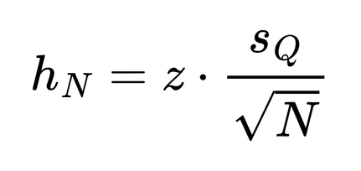
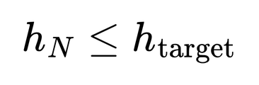
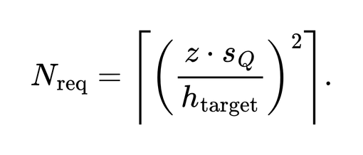
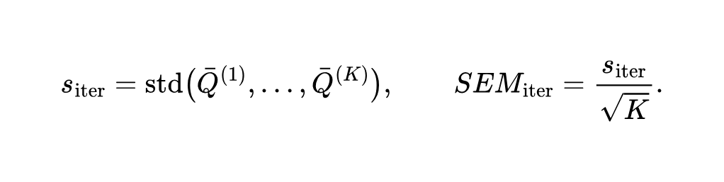
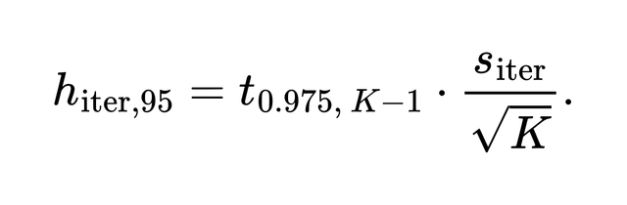
Pilot Study
Axion
Student Research
Group
A short pilot run selects the hardware budget before the full experiment, so results are statistically reliable and comparable.
shots – repetitions of one circuit per evaluation;
average over shots to fight quantum measurement noise
repeats – independent re-runs of that evaluation;
average over repeats to reduce IQM SPARK callibration drift
10 / 16
Notes:
The pilot controls the main sources of uncertainty: first, the number of shots, which affects finite-shot measurement noise; second, the number of samples, meaning random parameter samples or test inputs; and third, repeated hardware runs, which capture drift and calibration changes of the QPU.

Slide 9
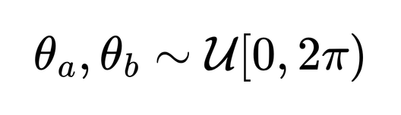
Meyer-Wallach
Axion
Student Research
Group
Meyer-Wallach gives a hardware-cheap measure of global entanglement from reduced states matrices.
Sample N random parameter vectors
12/ 16

Slide 10
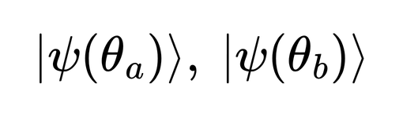
Meyer-Wallach
Axion
Student Research
Group
Meyer-Wallach gives a hardware-cheap measure of global entanglement from reduced states matrices.
Sample N random parameter vectors
Prepare N states on IQM Spark
12/ 16

Slide 11
Meyer-Wallach
Axion
Student Research
Group
Meyer-Wallach gives a hardware-cheap measure of global entanglement from reduced states matrices.
Sample N random parameter vectors
Prepare N states on IQM Spark
Reconstruct reduced density matrices
12/ 16

Slide 12
Meyer-Wallach
Axion
Student Research
Group
Meyer-Wallach gives a hardware-cheap measure of global entanglement from reduced states matrices.
Sample N random parameter vectors
Prepare N states on IQM Spark
Reconstruct reduced density matrices
Compute Meyer-Wallach score
12/ 16

Slide 13
Meyer-Wallach
Axion
Student Research
Group
Meyer-Wallach gives a hardware-cheap measure of global entanglement from reduced states matrices.
Sample N random parameter vectors
Prepare N states on IQM Spark
Reconstruct reduced density matrices
Compute Meyer-Wallach score
12/ 16

Slide 14
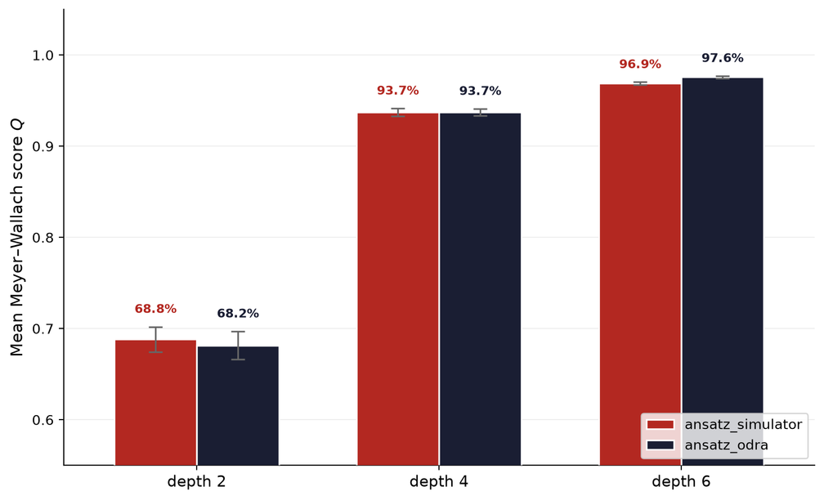
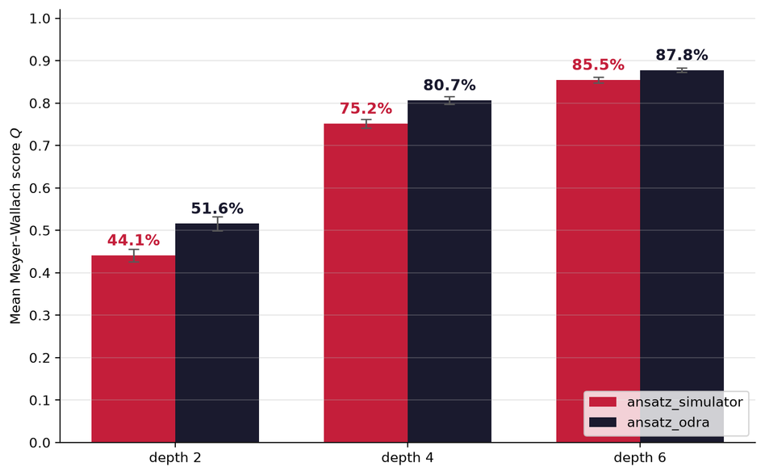
Meyer-Wallach - Results
Axion
Student Research
Group
Simulator-based test suggests a difference, that is not present/observable on QPU
Hardware Simulator
13 / 16

Slide 15
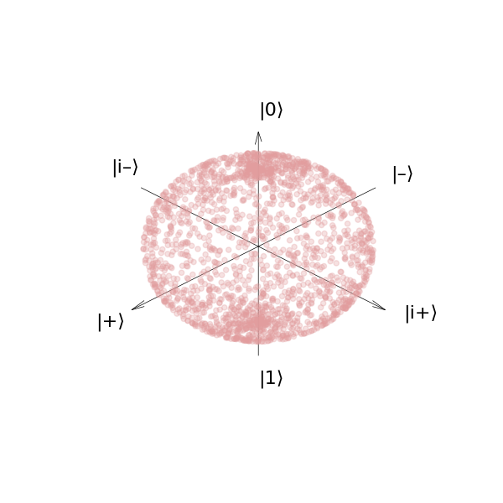
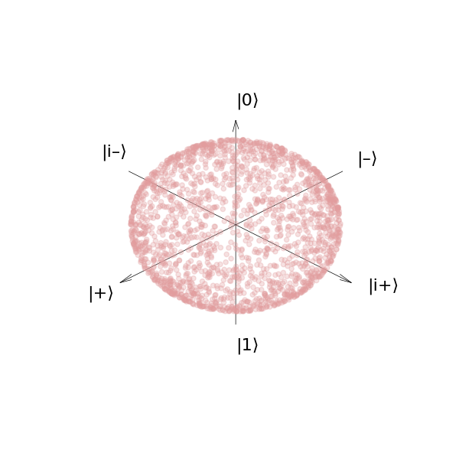
Expressibility
Axion
Student Research
Group
Expressibility measures how broadly an ansatz explores state space, against the Haar ideal.
Random:
Haar:
09/ 16
Understanding the Haar measure, Olivia Di Matteo

Slide 16
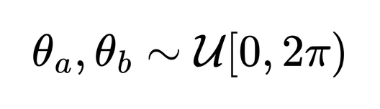
Expressibility — two complementary views
Axion
Student Research
Group
QPU track
Simulator track
How broadly does the ansatz explore state space?
Expressibility on real IQM Spark hardware
Includes noise, drift, and tomography error
Answers: what actually happens on device?
Metric: D_KL(P_QPU || P_Haar)
Ideal noiseless expressibility (statevector)
Upper bound for the same circuit definitions
Answers: what could the ansatz do without noise?
Metric: D_KL(P_Sim || P_Haar)
Kullback-Leibler (KL) divergence is a statistical measure that quantifies how much two probability distribution differ.
Same random parameter pairs, ansätze, depths, bins, and KL definition → results are directly comparable.
10 / 16

Slide 17
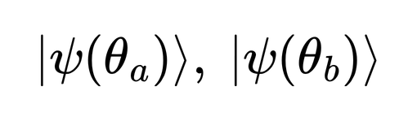
KL expressibility — shared protocol
Axion
Student Research
Group
Shared steps (both QPU and Simulator):
1. Sample random parameter pairs (θ_a, θ_b) — matched seeds
2. For each ansatz and depth, collect pairwise state overlaps F
3. Build empirical histogram P(F) and compare to analytic P_Haar(F)
4. Expressibility score: D_KL(P_emp || P_Haar) — lower is better
Kullback-Leibler (KL) divergence is a statistical measure that quantifies how much two probability distribution differ.
Sim et al., Adv. Quantum Technol. 2019 · Haar reference: Olivia Di Matteo
10 / 16

Slide 18
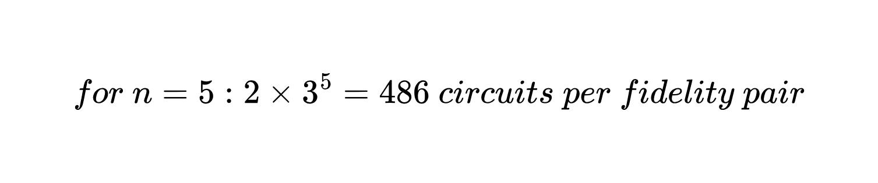
KL expressibility — QPU vs Simulator
Axion
Student Research
Group
QPU (IQM Spark)
Simulator (statevector)
Prepare two states on hardware
Full Pauli tomography (3^n bases)
F = Tr(ρ_a ρ_b) with shot noise
Costly — pilot-chosen shots, pairs, iterations
D_KL(P_QPU || P_Haar)
Evolve two ideal statevectors
Exact overlap |⟨ψ_a|ψ_b⟩|²
Noiseless fidelities
Cheap — thousands of pairs (e.g. 5000)
D_KL(P_Sim || P_Haar)
Kullback-Leibler (KL) divergence is a statistical measure that quantifies how much two probability distribution differ.
Same ansätze (ansatz_odra, ansatz_simulator) and depths on both tracks.
10 / 16

Slide 19
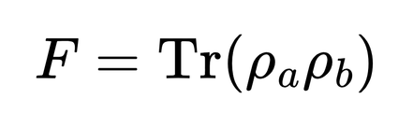
KL expressibility — from fidelities to score
Axion
Student Research
Group
θ pairs → QPU: tomography on Spark | Sim: statevector evolution
→ pairwise fidelities F → histogram P(F)
→ compare to P_Haar → KL score
Kullback-Leibler (KL) divergence is a statistical measure that quantifies how much two probability distribution differ.
• Same n_bins, ε-smoothing, and bootstrap confidence intervals
• Both ansätze tested at the same depths
• Sim: both ansätze approach Haar at depth 4; QPU shows a larger odra–simulator gap
Both tracks converge to the same analysis pipeline.
10 / 16

Slide 20
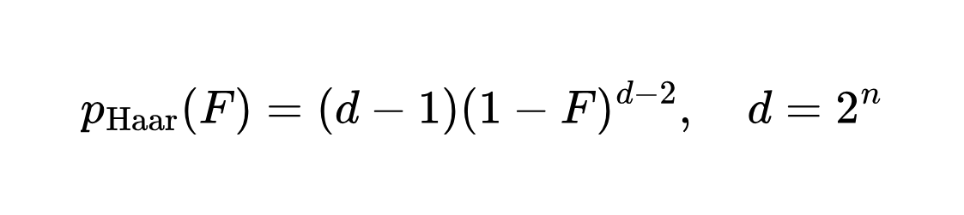
KL expressibility protocol
Axion
Student Research
Group
Kullback-Leibler (KL) divergence is a statistical measure that quantifies how much two probability distribution differ.
Sample random parameter pairs
Prepare both states on IQM Spark
Reconstruct density matrices with full Pauli tomography
Compute hardware-hardware overlap
Compare empirical fidelity histogram with Haar reference
S. Sim, P. D. Johnson, and A. Aspuru‐Guzik, "Expressibility and entangling capability of parameterized quantum circuits for hybrid quantum‐classical algorithms," Adv. Quantum Technol., vol. 2, no. 12, p. 1900070, Dec. 2019, doi: 10.1002/qute.201900070.
10/ 16

Slide 21
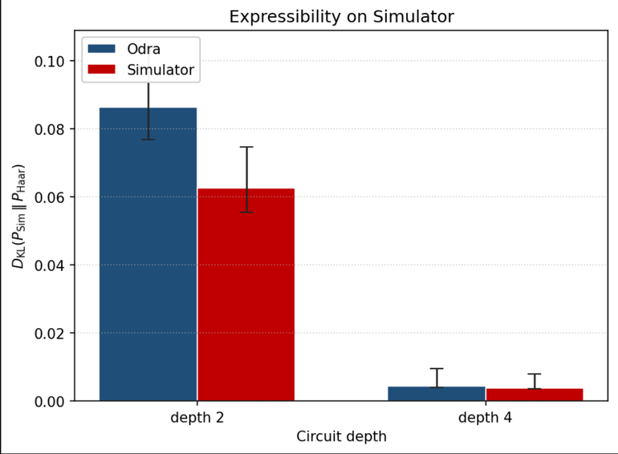
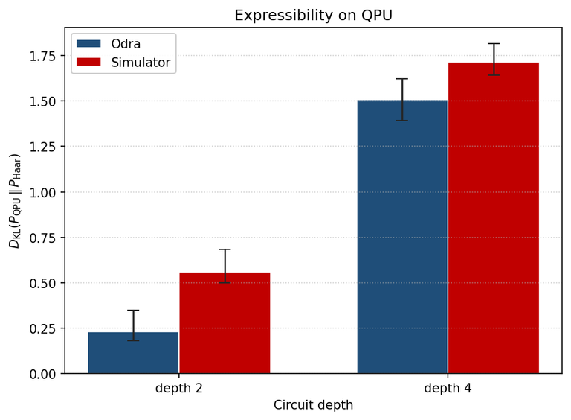
Expressibility - Results
Axion
Student Research
Group
What happened when we swapped to non-parameterized gates.
KL - divergance ∈ [0,∞] - lower is better.
11 / 16

Slide 22
Expressibility - Results
Axion
Student Research
Group
What happened when we swapped to non-parameterized gates.
KL - divergance ∈ [0,∞] - lower is better.
odra worse
odra better
At equal depth the native ansatz explores less of the state space than the simulator ansatz.
11 / 16

Slide 23
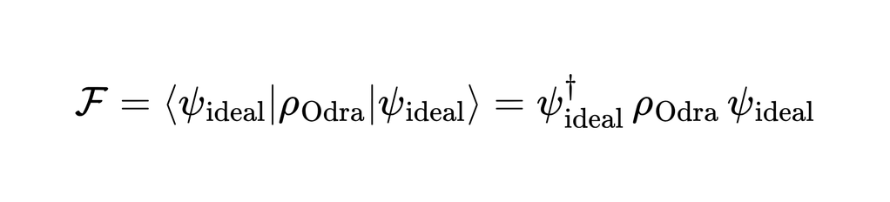
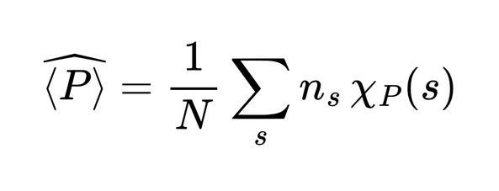
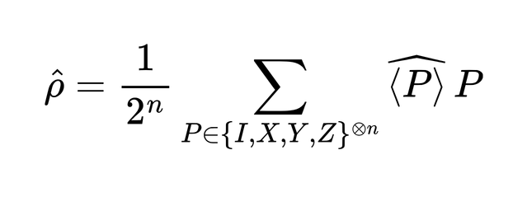
Fidelity - tomography
Axion
Student Research
Group
Fidelity checks how well QPU prepare the state our simulation intended.
We reconstruct the hardware density matrix from Pauli-basis measurements on the QPU and compare it with the ideal simulated state through fidelity.
07 / 16

Slide 24
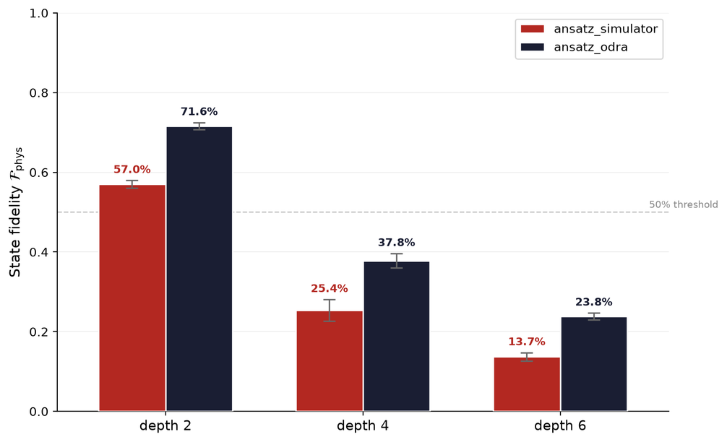
Fidelity - results
Axion
Student Research
Group
How much does the decomposition affects both ansatze.
State fidelity ∈ [0,1] - higher is better.
08 / 16

Slide 25
Fidelity - results
Axion
Student Research
Group
How much does the decomposition affects both ansatze.
State fidelity ∈ [0,1] - higher is better.
more than 10pp difference
suggest the ansatz collapse
ansatz_simulator has significantly worse results on real hardware than ansatz_odra
Depth 6 results suggest its collapse on hardware.
08 / 16

Slide 26
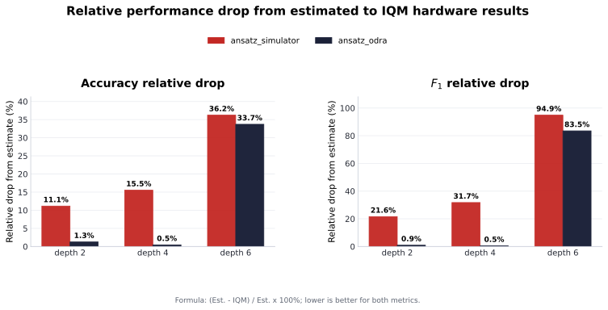
Metrics gap between simulator and QPU
Axion
Student Research
Group
lower is better
13 / 16

Slide 27
Metrics gap between simulator and QPU
Axion
Student Research
Group
lower is better
the transmission gap for ansatz_odra is almost 0%
13 / 16

Slide 28
Metrics gap between simulator and QPU
Axion
Student Research
Group
lower is better
collapse at depth 6 resulting from exceeding the device's noise budget
13 / 16

Slide 29
Conclusions
Axion
Student Research
Group
We started from a simple problem: ansätze are usually validated in simulation, but their real behavior depends on QPU constraints. We created framework for evaluation which consists of few tests
14 / 16

Slide 30
Conclusions
Axion
Student Research
Group
We started from a simple problem: ansätze are usually validated in simulation, but their real behavior depends on QPU constraints. We created framework for evaluation which consists of few tests
Fidelity
how well can we represent the ideal state?
14 / 16

Slide 31
Conclusions
Axion
Student Research
Group
We started from a simple problem: ansätze are usually validated in simulation, but their real behavior depends on QPU constraints. We created framework for evaluation which consists of few tests
Fidelity
how well can we represent the ideal state?
KL expressibility
how does QPU noise change expressibility?
14 / 16

Slide 32
Conclusions
Axion
Student Research
Group
We started from a simple problem: ansätze are usually validated in simulation, but their real behavior depends on QPU constraints. We created framework for evaluation which consists of few tests
Fidelity
how well can we represent the ideal state?
KL expressibility
how does QPU noise change expressibility?
Meyer-Wallach
how entangled is each qubit?
14 / 16

Slide 33
Takeaways
Axion
Student Research
Group
We need to verify the ansatz on the hardware, not just on the simulator
15/16

Slide 34
Takeaways
Axion
Student Research
Group
We need to verify the ansatz on the hardware, not just on the simulator
Evaluating Ansatz requires more than one metric, it should be a series of tests like the one we proposed
Future work:
Alternative quantum hardware, diverse datasets, and diverse problem types to ensure broad applicability.
15/16

Slide 35


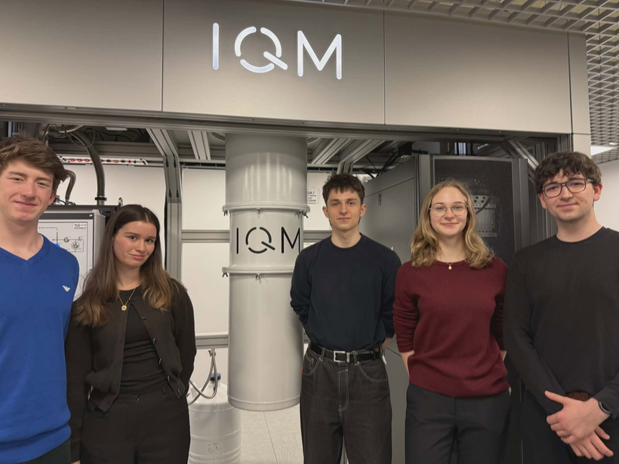
Contact information:
Axion
Student Research
Group
E-mail: kn.axion@pwr.edu.pl
Website: https://axion.pwr.edu.pl/pl/
LinkedIn: KN Axion
Acknowledgment:
16/16
Full code and Results on GitHub: QC1_Quantum_Banknote_Classifier_on_ODRA_5

Slide 36
Axion
Student Research
Group
Addon
02 / 16

Slide 37
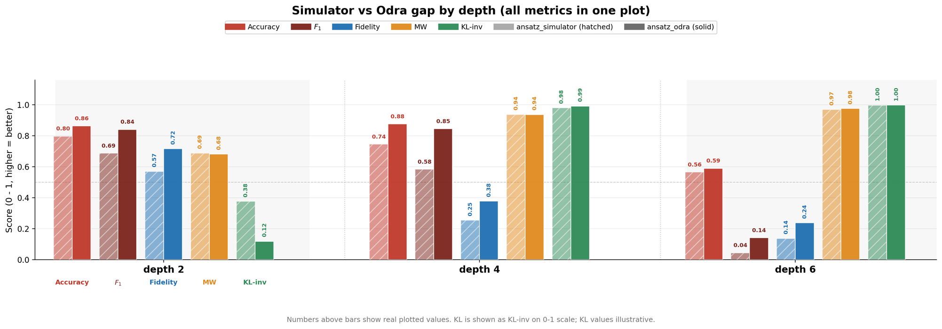
Results???????
Axion
Student Research
Group
colapse predicted by protocol
13 / 16

Slide 38
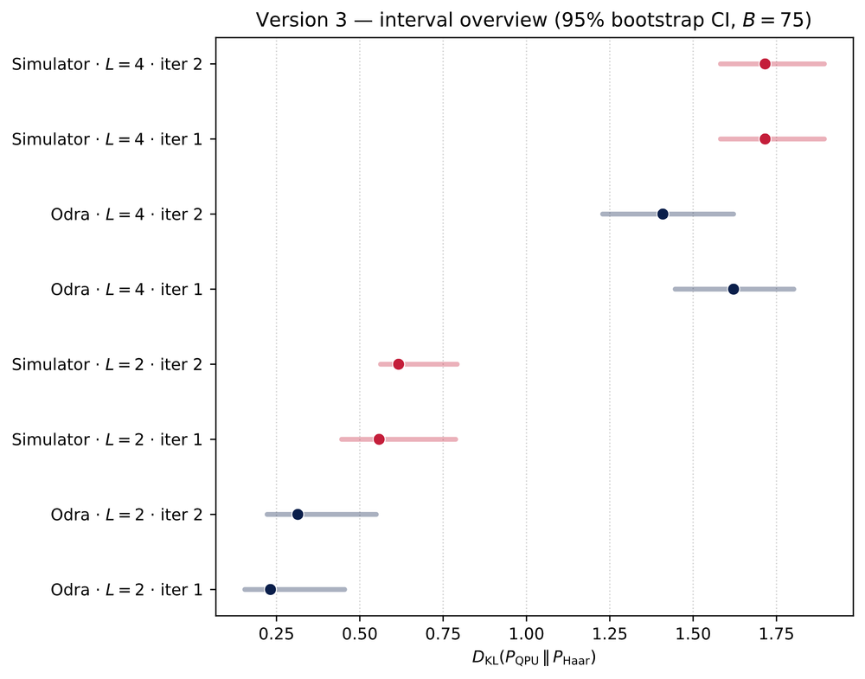
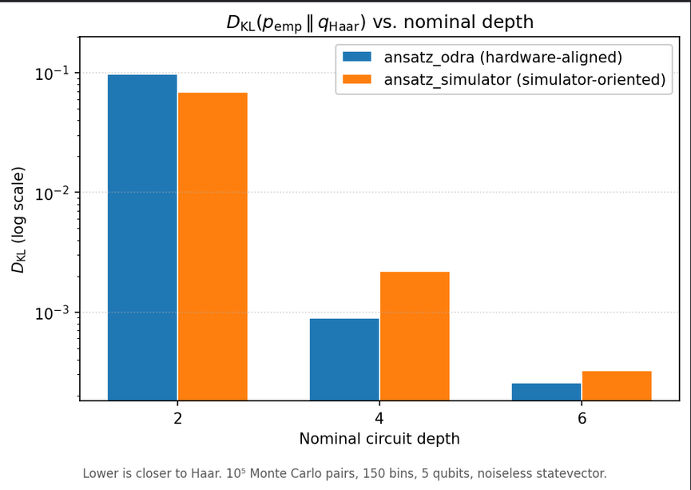
Expressibility - Full results
Axion
Student Research
Group

